Slide 1
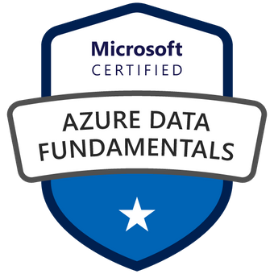

Exam DP-900: Microsoft Azure Data Fundamentals Crash Course
Tim Warner

Slide 2


Tim Warner
Based in Nashville, TN, US
Central time zone
MCT, MVP
Twitter: @TechTrainerTim
Badge: TechTrainerTim.com

Slide 3
Poll Question
Why are you taking this class?
A: General knowledge
B: Azure Data Fundamentals certification
C: Data Fundamentals + Data Engineer certification

Slide 4
Session 1 of 2 Agenda
Introduction
Core Data Concepts
Non-Relational Data
Relational Data (start)

Slide 5
Session 2 of 2 Agenda
Content catch-up
Relational Data (finish)
Data Analytics
Exam DP-900 strategy

Slide 6
Course Materials
timw.info/dp900

Slide 7
A Different Kind of Training
We'll learn by doing – at least 80 percent demo
Visual, case study approach
This is an expert certification, so we will move quickly and assume intermediate-level Azure skills
5-minute break at midpoint
I’m here to answer your questions – take advantage of this!
Use the Q&A panel

Slide 8

Session Recordings

Slide 9

Session Recordings

Slide 10

Session Recordings

Slide 11
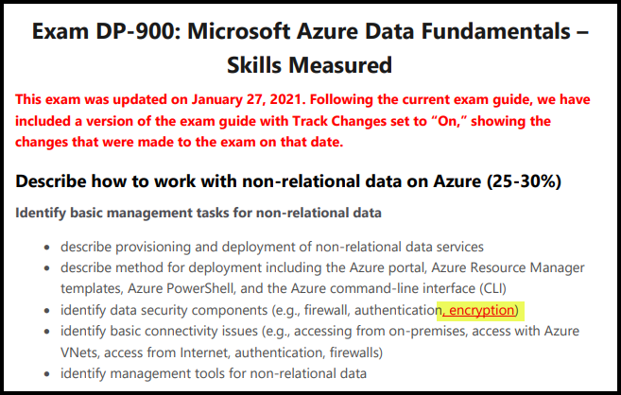
DP-900 Changes: January 27, 2021

Slide 12
Tim's Certification Study Pyramid
Interdependence
Content knowledge
Practical application
Test-taking skills

Slide 13
Thank you!
Course materials: timw.info/dp900
Twitter: @TechTrainerTim
Work: timw.info/ps
Web: TechTrainerTim.com

Slide 14
Core Data Concepts

Slide 15
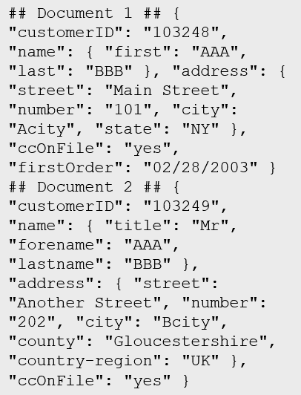
Data Types
Structured
Semi-structured
Unstructured
Table

Slide 16

Data Workload Types
Online Transactional Processing (OLTP)
Online Analytical Processing (OLAP)
Customer
CustomerID | CustomerName | CustomerPhone
Orders
OrderID | CustomerID | OrderDate
Data is periodically loaded, aggregated and stored in a cube
Data is stored one transaction at a time

Slide 17

Data Processing Types
Batch
Streaming

Slide 18





Data Analytics
On-premises data
SQL Server, Oracle, fileshares, SAP
Data ingestion
Data storage
Data processing
Data visualization
Cloud data
Azure, AWS, GCP
SaaS data
Salesforce, Dynamics

Slide 19
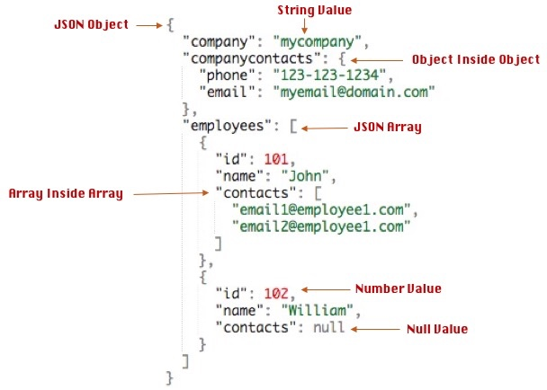
Data Formats - JSON

Slide 20
Query Tools
Azure Portal
Azure Storage Explorer
Azure Data Studio
Visual Studio Code
SQL Server Management Studio
PowerShell
Azure CLI
MySQL Workbench

Slide 21
Non-Relational Data

Slide 22
Non-Relational Data Characteristics
## Customer 1 ID: 1
Name: Mark Hanson
Telephone: [ Home: 1-999-9999999, Business: 1-888-8888888, Cell: 1-777- 7777777 ]
Address: [ Home: 121 Main Street, Some City, NY, 10110,
Business: 87 Big Building, Some City, NY, 10111 ]
## Customer 2 ID: 2
Title: Mr
Name: Jeff Hay
Telephone: [ Home: 0044-1999-333333, Mobile: 0044-17545-444444 ]
Address: [ UK: 86 High Street, Some Town, A County, GL8888, UK,
US: 777 7th Street, Another City, CA, 90111 ]
Non-relational collections can have:
Multiple entities in the same collection or container with different fields
Have a different, non-tabular schema
Are often defined by labeling each field with the name it represents

Slide 23
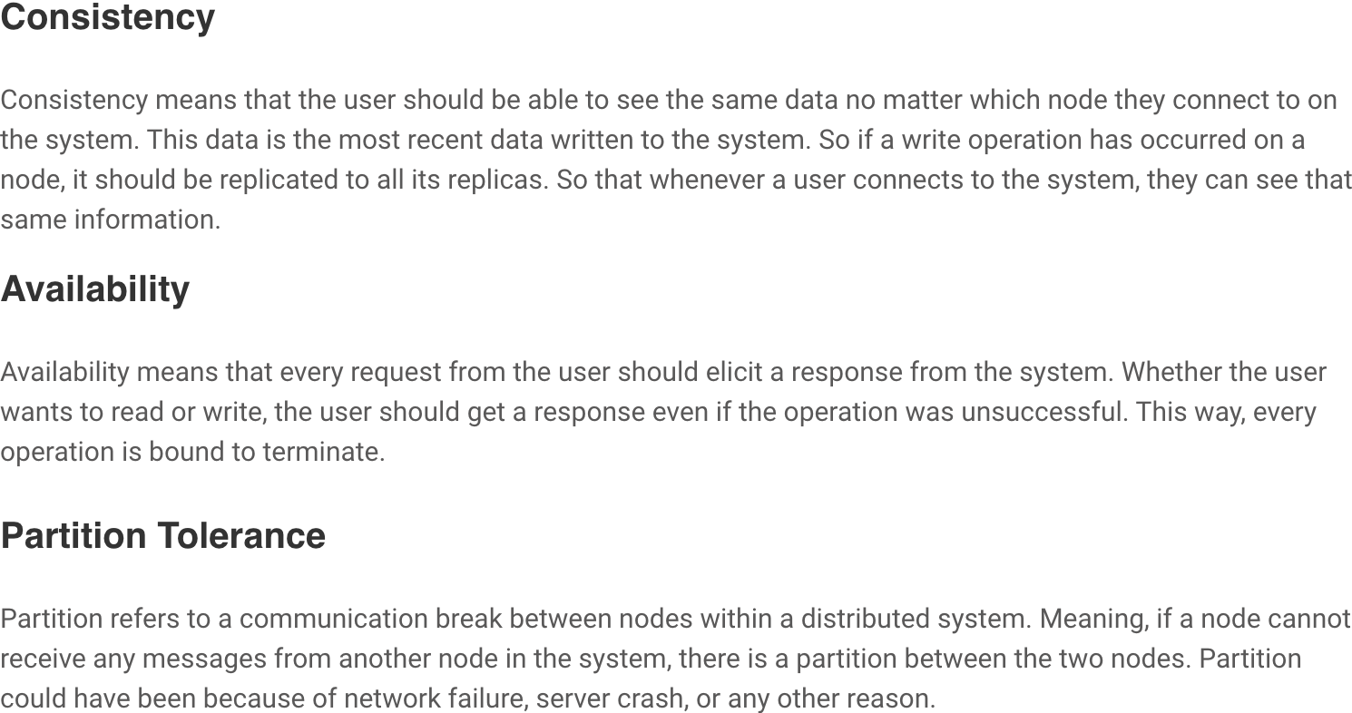
CAP Theorem

Slide 24
Azure Blob Storage
Block blobs
Page blobs
Append blobs
Has a maximum size of 4.7TB
Best for storing large, discrete, binary objects that changes infrequently
Each individual block can store up to 100MB of data
A block blob can contain up to 50000 blocks
Can hold up to 8TB of data
Is organized as a collection of fixed sized-512 byte pages
Used to implement virtual disk storage for virtual machines
The maximum size is just over 195GB
Is a block blob that is used to optimize append operations
Each individual block can store up to 4MB of data

Slide 25
Azure Table Storage
Key (Customer ID)
Value (Customer Data)
C1
AAAAA
BBB
101 Block Street
YY
999
888
C2
MM
NN
21 A Street
5 B Avenue
C3
DDD
EEE
FFF
111
222
66 C Road

Slide 26
Azure Cosmos DB
Scalability
Performance
Availability
Programming model

Slide 27
Cosmos DB APIs
SQL API
Table API
MongoDB API
Cassandra API
Gremlin API
Supports SQL-like query language
Compatible with Azure Table Storage
Compatible with MongoDB
Compatible with Cassandra
A graph database

Slide 28
Cosmos DB SQL API
COUNT( <fields_to_count> )
SUM( <numeric_fields> )
AVG( <numeric_fields> )
MAX( <numeric_fields> )
MIN( <numeric_fields> )
Aggregation Function Basics
SQL API examples
SELECT COUNT(*) FROM Products p
SELECT SUM(p.quantity) FROM Products p
WHERE p.expired = 0
SELECT AVG(p.price) AS ‘Average Price’
FROM Products p
SELECT p1.ID, p.Name, p1.Description, p1.Price FROM Products p1
WHERE p1.Price = (SELECT MIN(p2.Price) FROM Product p2)

Slide 29
Relational Data

Slide 30

Relational Database Use Cases
Identify relational database use cases
IoT:
Although typically considered for non-relational, the data from IoT devices could be structured and consistent
Online transaction processing:
For example order systems that perform many small transactional updates
Data warehousing:
Large amounts of data can be imported from multiple sources and structured to enable high-performance queries

Slide 31
Relational Database Tables
Customers
CustomerID | CustomerName | CustomerPhone
100 | Muisto Linna | XXX-XXX-XXXX
101 | Noam Maoz | XXX-XXX-XXXX
102 | Vanja Matkovic | XXX-XXX-XXXX
103 | Qamar Mounir | XXX-XXX-XXXX
104 | Zhenis Omar | XXX-XXX-XXXX
105 | Claude Paulet | XXX-XXX-XXXX
106 | Alex Pettersen | XXX-XXX-XXXX
107 | Francis Ribeiro | XXX-XXX-XXXX
Data is stored in a table
Table consists of rows and columns
All rows have same # of columns
Each column is defined by a datatype

Slide 32
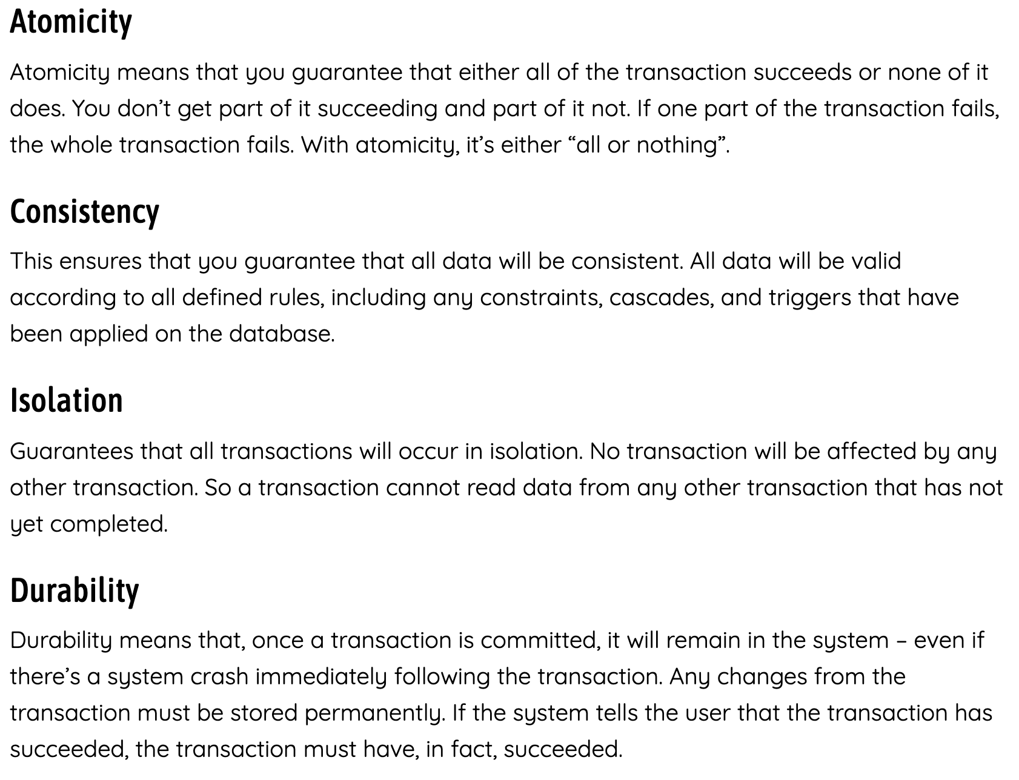
ACID Principle

Slide 33
Normalization
Customers
CustomerID | CustomerName | CustomerPhone
100 | Muisto Linna | XXX-XXX-XXXX
101 | Noam Maoz | XXX-XXX-XXXX
102 | Vanja Matkovic | XXX-XXX-XXXX
103 | Qamar Mounir | XXX-XXX-XXXX
104 | Zhenis Omar | XXX-XXX-XXXX
105 | Claude Paulet | XXX-XXX-XXXX
106 | Alex Pettersen | XXX-XXX-XXXX
Orders
OrderID | CustomerName | CustomerPhone
AD100 | Noam Maoz | XXX-XXX-XXXX
AD101 | Noam Maoz | XXX-XXX-XXXX
AD102 | Noam Maoz | XXX-XXX-XXXX
AX103 | Qamar Mounir | XXX-XXX-XXXX
AS104 | Qamar Mounir | XXX-XXX-XXXX
AR105 | Claude Paulet | XXX-XXX-XXXX
MK106 | Muisto Linna | XXX-XXX-XXXX
Data is normalized to:
Reduce storage
Avoid data duplication
Improve data quality

Slide 34

Table Relationships
Customers
CustomerID | CustomerName | CustomerPhone
100 | Muisto Linna | XXX-XXX-XXXX
101 | Noam Maoz | XXX-XXX-XXXX
102 | Vanja Matkovic | XXX-XXX-XXXX
103 | Qamar Mounir | XXX-XXX-XXXX
104 | Zhenis Omar | XXX-XXX-XXXX
105 | Claude Paulet | XXX-XXX-XXXX
106 | Alex Pettersen | XXX-XXX-XXXX
Orders
OrderID | CustomerID | SalesPersonID
AD100 | 101 | 200
AD101 | 101 | 200
AD102 | 101 | 200
AX103 | 103 | 201
AS104 | 103 | 201
AR105 | 105 | 200
MK106 | 105 | 201
In a normalized database schema:
Primary Keys and Foreign keys are used to define relationships
No data duplication exists (other than key values in 3rd Normal Form (3NF)
Data is retrieved by joining tables together in a query

Slide 35
Indexes
Customers
CustomerID | CustomerName | CustomerPhone
100 | Muisto Linna | XXX-XXX-XXXX
101 | Noam Maoz | XXX-XXX-XXXX
102 | Vanja Matkovic | XXX-XXX-XXXX
103 | Qamar Mounir | XXX-XXX-XXXX
104 | Zhenis Omar | XXX-XXX-XXXX
105 | Claude Paulet | XXX-XXX-XXXX
106 | Alex Pettersen | XXX-XXX-XXXX
IDX-CustomerRegion
CustomerID | Region
100 | France
101 | Brazil
102 | Croatia
103 | Jordan
104 | Spain
105 | France
106 | USA
An index:
Optimizes search queries for faster data retrieval
Reduces the amount of data pages that need to be read to retrieve the data in a SQL Statement
Data is retrieved by joining tables together in a query

Slide 36
Views
Customers
CustomerID | CustomerName | CustomerPhone
100 | Muisto Linna | XXX-XXX-XXXX
101 | Noam Maoz | XXX-XXX-XXXX
102 | Vanja Matkovic | XXX-XXX-XXXX
103 | Qamar Mounir | XXX-XXX-XXXX
104 | Zhenis Omar | XXX-XXX-XXXX
105 | Claude Paulet | XXX-XXX-XXXX
106 | Alex Pettersen | XXX-XXX-XXXX
Orders
OrderID | CustomerID | SalesPersonID
AD100 | 101 | 200
AD101 | 101 | 200
AD102 | 101 | 200
AX103 | 103 | 201
AS104 | 103 | 201
AR105 | 105 | 200
MK106 | 105 | 201
DB205 | 100 | 205
Create the definition of a view:
CREATE VIEW vw_customerorders AS
SELECT Customers.CustomerID, Customers.CustomerName, Orders.OrderID FROM Customers JOIN Orders on Customers.CustomerID = Orders.CustomerID
Retrieve the orders placed by customer 102 using the view:
SELECT CustomerName, OrderID from vw_customerorders WHERE CustomerID=102
A view is a virtual table based on the result set of query:
Views are created to simplify the query
Combine relational data into a single pane view

Slide 37
SQL Statement Categories
DML
DDL
DCL
Data Manipulation Language
Used to query and manipulate data
SELECT, INSERT, UPDATE, DELETE
Data Definition Language
Used to define database objects
CREATE, ALTER, DROP, RENAME
Data Control Language
Used to manage security permissions
GRANT, REVOKE, DENY

Slide 38
SQL DML Statements
Statement | Description
SELECT | Select/read from a table
INSERT | Insert new rows in a table
UPDATE | Edit/Update existing rows in a table
DELETE | Delete existing rows in a table

Slide 39
SELECT Statement
SELECT EmployeeId, YEAR(OrderDate) AS OrderYear
FROM Sales.Orders
WHERE CustomerId = 71
GROUP BY EmployeeId, YEAR(OrderDate)
HAVING COUNT(*) > 1
ORDER BY EmployeeId, OrderYear;

Slide 40
INSERT Statement
The INSERT ... VALUES statement inserts a new row
INSERT INTO Sales.OrderDetails
(orderid, productid, unitprice, qty, discount)
VALUES (10255,39,18,2,0.05);
Table and row constructors add multirow capability to INSERT ... VALUES
INSERT INTO Sales.OrderDetails
(orderid, productid, unitprice, qty, discount)
VALUES
(10256,39,18,2,0.05),
(10258,39,18,5,0.10);

Slide 41
SQL DML Statements
Statement | Description
CREATE | Create a new object in the database, such as a table or a view
ALTER | Modify the structure of an object. For instance, altering a table to add a new column.
DROP | Remove an object from the database.
RENAME | Rename an existing object.

Slide 42
CREATE Statement
CREATE TABLE Mytable
(Mycolumn1 int NOT NULL PRIMARY KEY, Mycolumn2 VARCHAR(50) NOT NULL , Mycolumn2 VARCHAR(10) NOT NULL

Slide 43
Data Analytics

Slide 44
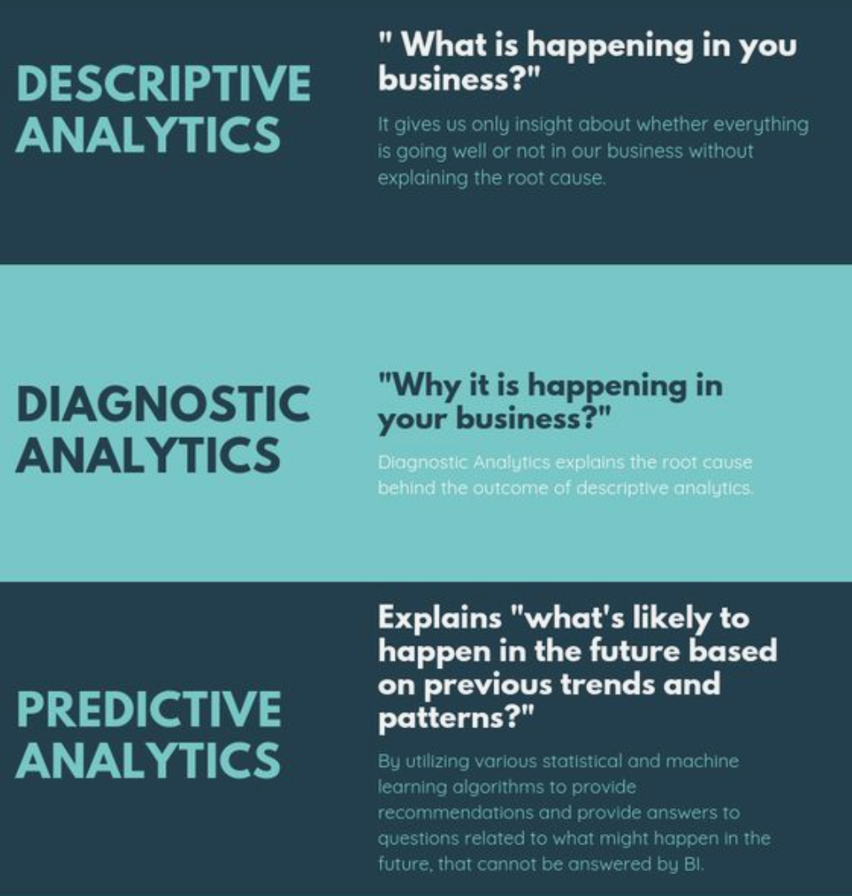
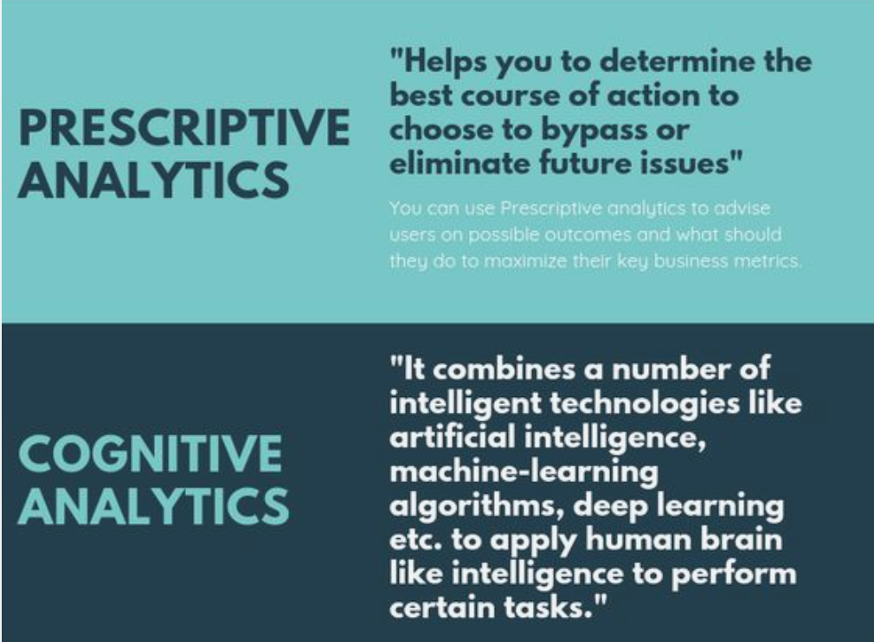
Data Analytics - Types

Slide 55
What is data ingestion?
Notes:
Instructor notes
Ingestion is the process of importing data which might come in the form of a stream or in batches.

Slide 56
What is data processing?
Notes:
Instructor notes
Data processing takes the data in its raw form, cleans it, and converts it into a more meaningful format.

Slide 57
What is ETL?
Notes:
Instructor notes
ETL stands for *Extract, Transform, and Load*. The raw data is retrieved and transformed before being saved. The extract, transform, and load steps can be performed as a continuous pipeline of operations. It is suitable for systems that only require simple models, with little dependency between items.

Slide 58
What is ELT?
Notes:
Instructor notes
The data processing engine can take an iterative approach, retrieving and processing the data from storage, before writing the transformed data and models back to storage. ELT is more suitable for constructing complex models that depend on multiple items in the database, often using periodic batch processing.

Slide 59
Explore data visualization
Power BI: A collection of software, services, apps, and connectors
Notes:
Instructor notes
Microsoft Power BI is a collection of software services, apps, and connectors that work together to turn your unrelated sources of data into coherent, visually immersive, and interactive insights. Whether your data is a simple Microsoft Excel workbook, or a collection of cloud-based and on-premises hybrid data warehouses, Power BI lets you easily connect to your data sources, visualize (or discover) what's important, and share that with anyone or everyone you want.
Desktop: A free application you install on your local computer that lets you connect to, transform, and visualize your data.
Service: A SaaS service which brings together dashboards, workspaces, reports, and datasets for keeping a finger on the pulse of your business.
Mobile: Connect to and interact with your cloud and on-premises data. You create reports in Power BI Desktop. You create dashboards, and view dashboards and reports in the Power BI report service. You view on-premises Power BI reports on Power BI Report Server. All these reports and dashboards are available in the Power BI mobile apps, whether they're on premises or in the cloud.
How you use Power BI might depend on your role on a project or a team. And other people, in other roles, might use Power BI differently, which is just fine.
The flow of work in Power BI
A common flow of work in Power BI begins in Power BI Desktop, where a report is created. That report is then published to the Power BI service and finally shared, so that users of Power BI Mobile apps can consume the information.

Slide 60
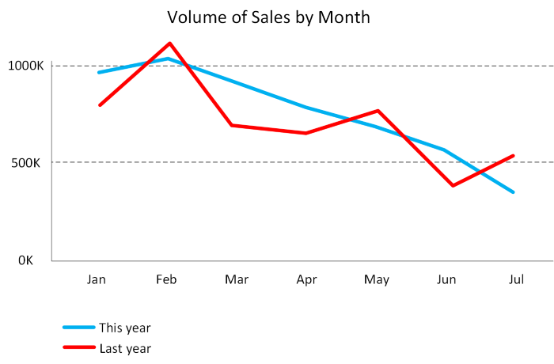
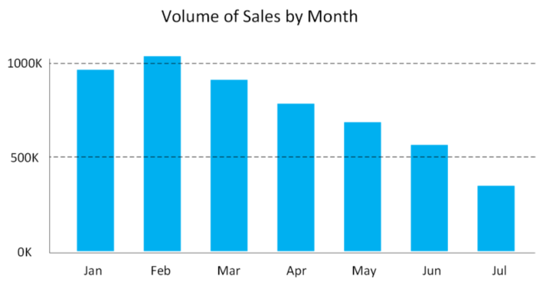
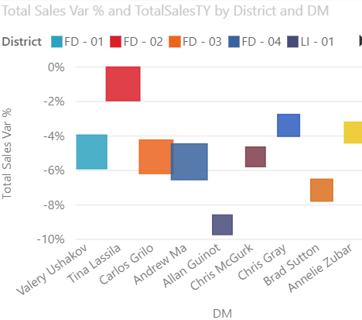
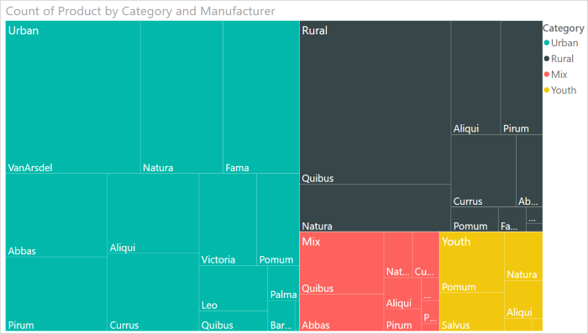
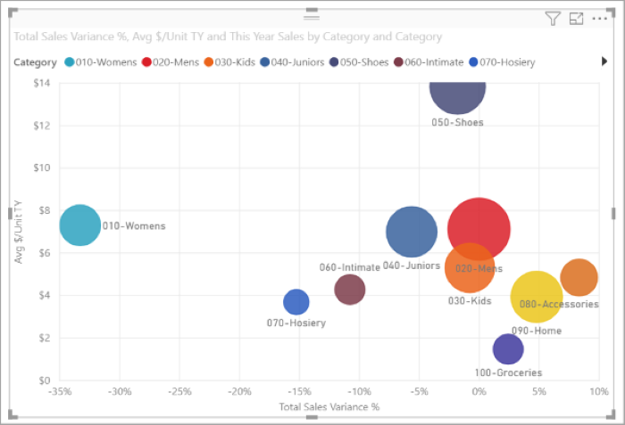
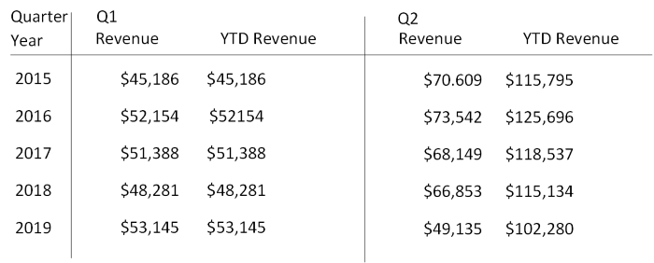
Power BI
Visualizations
Notes:
Instructor notes
Some examples of the many types of visualizations available in Power BI.

Slide 61
Explore data analytics
Descriptive
Diagnostic
Predictive
Prescriptive
Cognitive
Notes:
Instructor notes
Descriptive Analytics
The world of analytics, is evolving from the typical “Descriptive Analytics”, which is all about – What is happening in my business?
Diagnostic Analytics
The data insights, provided by descriptive analytics, are needed to provide the answer to: , “Why it is happening in your business”, which is often referred to analyzing root cause, or “Diagnostic Analytics”
Both, Descriptive and Diagnostic Analytics, is seen as a workload which is primarily providing a reactive response --- from what is happening, why is it happening, to what I am I going to do about it?
Predictive Analytics
By building out predictive patterns on top of your data, by utilizing the data findings from Descriptive, Diagnostic and Predictive data, you’ll be able to identify what is based on what you get from descriptive and diagnostic analytics and used to find answers to the question of what is likely to happen in the future based on previous trends and patterns?
Prescriptive Analytics
Techniques used to provide a predictive insights into your data, is commonly introduced by building out machine learning models, to “predict” trends and give the answer to the very
When you get the findings from Descriptive, Diagnostic and Predictive analytics like what’s happened, the root cause behind that and what-might-happen in future, Prescriptive model utilizes those answers to help you determine the best course of action to choose to bypass or eliminate future issues.
Cognitive Analytics
Cognitive analytics combines a number of intelligent technologies like artificial intelligence, machine-learning algorithms, deep learning etc.to apply human brain like intelligence to perform certain tasks. Basically, this type of analytics is inspired by how the human brain processes information, draws conclusions and codifies instincts and experience into learning such as understanding not only the words in a text but the full context of what is being written or spoken.

Slide 62




What is modern data warehousing?
Ingest & Prep
Model & Serve
Visualize
Azure Data Factory
Azure Synapse Analytics
(Data Warehouse)
Power BI
Code-free data transformation and ingestion from 90+ data integration connectors
Leader in the Magic Quadrant for Business Intelligence and Analytics Platforms*
Up to 14x faster and costs 94% less than other cloud providers
Azure Databricks (Data prep)
Up to 10x faster than vanilla Spark
Store
Azure Data Lake Storage
High performance data lake available in all 54 Azure regions
Notes:
Instructor notes
A modern data warehouse might contain a mixture of relational and non-relational data, including files, social media streams, and Internet of Things (IoT) sensor data.
Azure provides a collection of services you can use to build a data warehouse solution, including Azure Data Factory, Azure Data Lake Storage, Azure Databricks, Azure Synapse Analytics, and Azure Analysis Services.
You can use tools such as Power BI to analyze and visualize the data, generating reports, charts, and dashboards.

Slide 63
Combine batch and stream processing
Ingest & Prep
Model & Serve
Visualize
Azure Data Factory
Azure Synapse Analytics
(Data Warehouse)
Power BI
Logs (unstructured)
Code-free data transformation and ingestion from 90+ data integration connectors
Leader in the Magic Quadrant for Business Intelligence and Analytics Platforms*
Up to 14x faster and costs 94% less than other cloud providers
Media (unstructured)
Azure Databricks (Data prep)
Up to 10x faster than vanilla Spark
Files (unstructured)
Store
Azure Data Lake Storage
Business/custom apps (structured)
High performance data lake available in all 54 Azure regions
Notes:
The data sources on the left will include live data such as stock market data which will be streamed instantly.
There will also be data coming from historical sources such as past sales. This data could be loaded monthly.
A third type of data would be live sales. This can be streamed instantly as well as loaded as a batch into the historical sales data.
You should run through the paths that data can take including, for example:
Completely live data could come from a log, to Azure Data Factory to be prepped, to Synapse analytics to be modelled, to Power BI to be Visualized.
Live sales data could come from an app, to Azure Data Factory to be prepped, to Synapse analytics to be modelled, to Power BI to be Visualized.
Periodically sales data is ingested by Databricks and stored in Data Lake. This data is combined with live data by Synapse Analytics to compare live and historical data in Power BI.

Slide 64
What is Azure Data Lake storage?
A repository of data for your Modern Data Warehouse
Organises data into directories for improved file access
Supports POSIX and RBAC permissions
It is compatible with Hadoop Distributed File System
Store
Azure Data Lake Storage
High performance data lake available in all 54 Azure regions
Notes:
Instructor notes
A data lake is a repository for large quantities of raw data. Because the data is raw and unprocessed, it's very fast to load and update, but the data hasn't been put into a structure suitable for efficient analysis.

Slide 65
What is Azure Databricks?
Apache Spark-based platform:
Simplifies the provisioning and collaboration of Apache Spark-based analytical solutions
Enterprise Security:
Utilizes the security capabilities of Azure
Integration with Azure services:
Can integrate with a variety of Azure data platform services and Power BI
Notes:
Instructor notes
Azure Databricks is an Apache Spark environment running on Azure to provide big data processing, streaming, and machine learning.

Slide 66
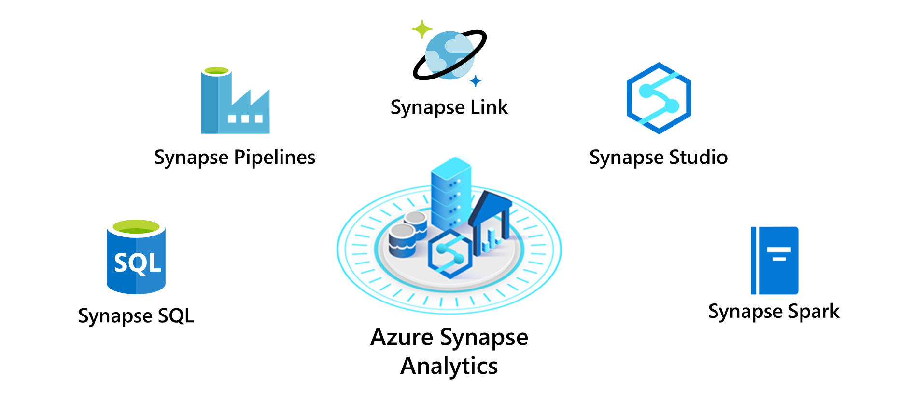
What is Azure Synapse Analytics?
Notes:
Instructor notes
Azure Synapse Analytics is an evolution of Azure SQL Data Warehouse.
Azure Synapse Analytics is an analytics engine. It's designed to process large amounts of data very quickly.
Using Synapse Analytics, you can ingest data from external sources, such as flat files, Azure Data Lake, or other database management systems, and then transform and aggregate this data into a format suitable for analytics processing.

Slide 67
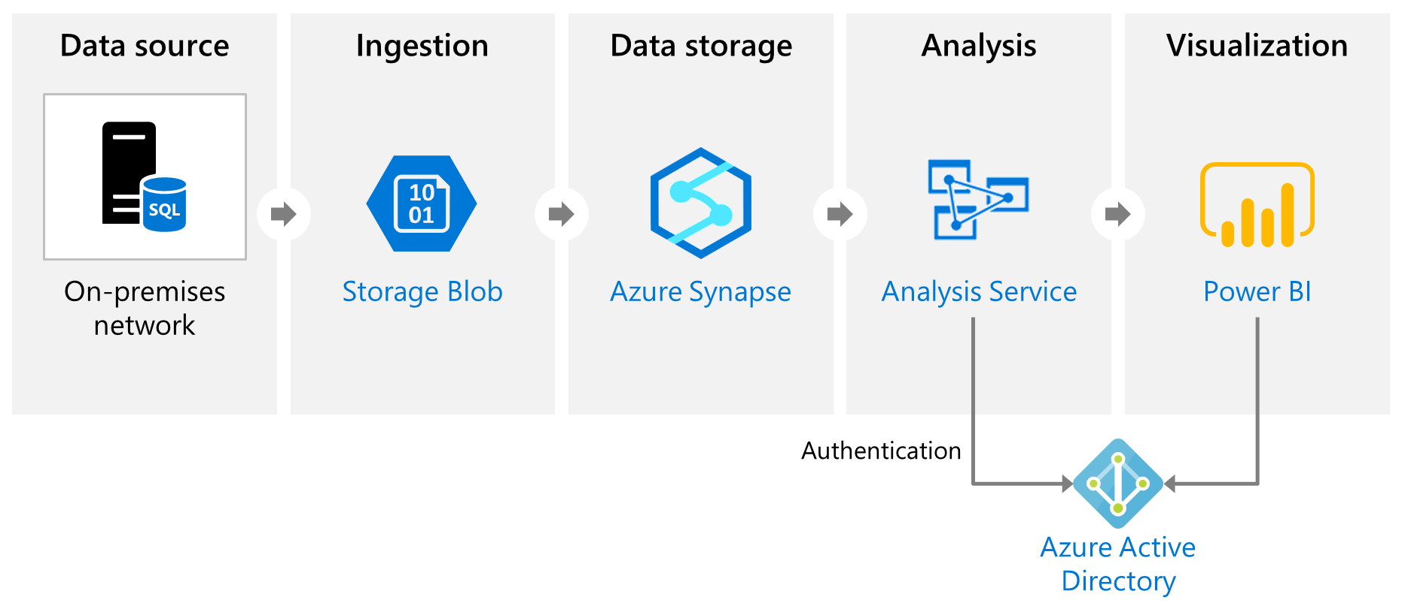
What is Azure Analysis Services?
Notes:
Instructor notes
Azure Analysis Services enables you to build tabular models to support online analytical processing (OLAP) queries.

Slide 68
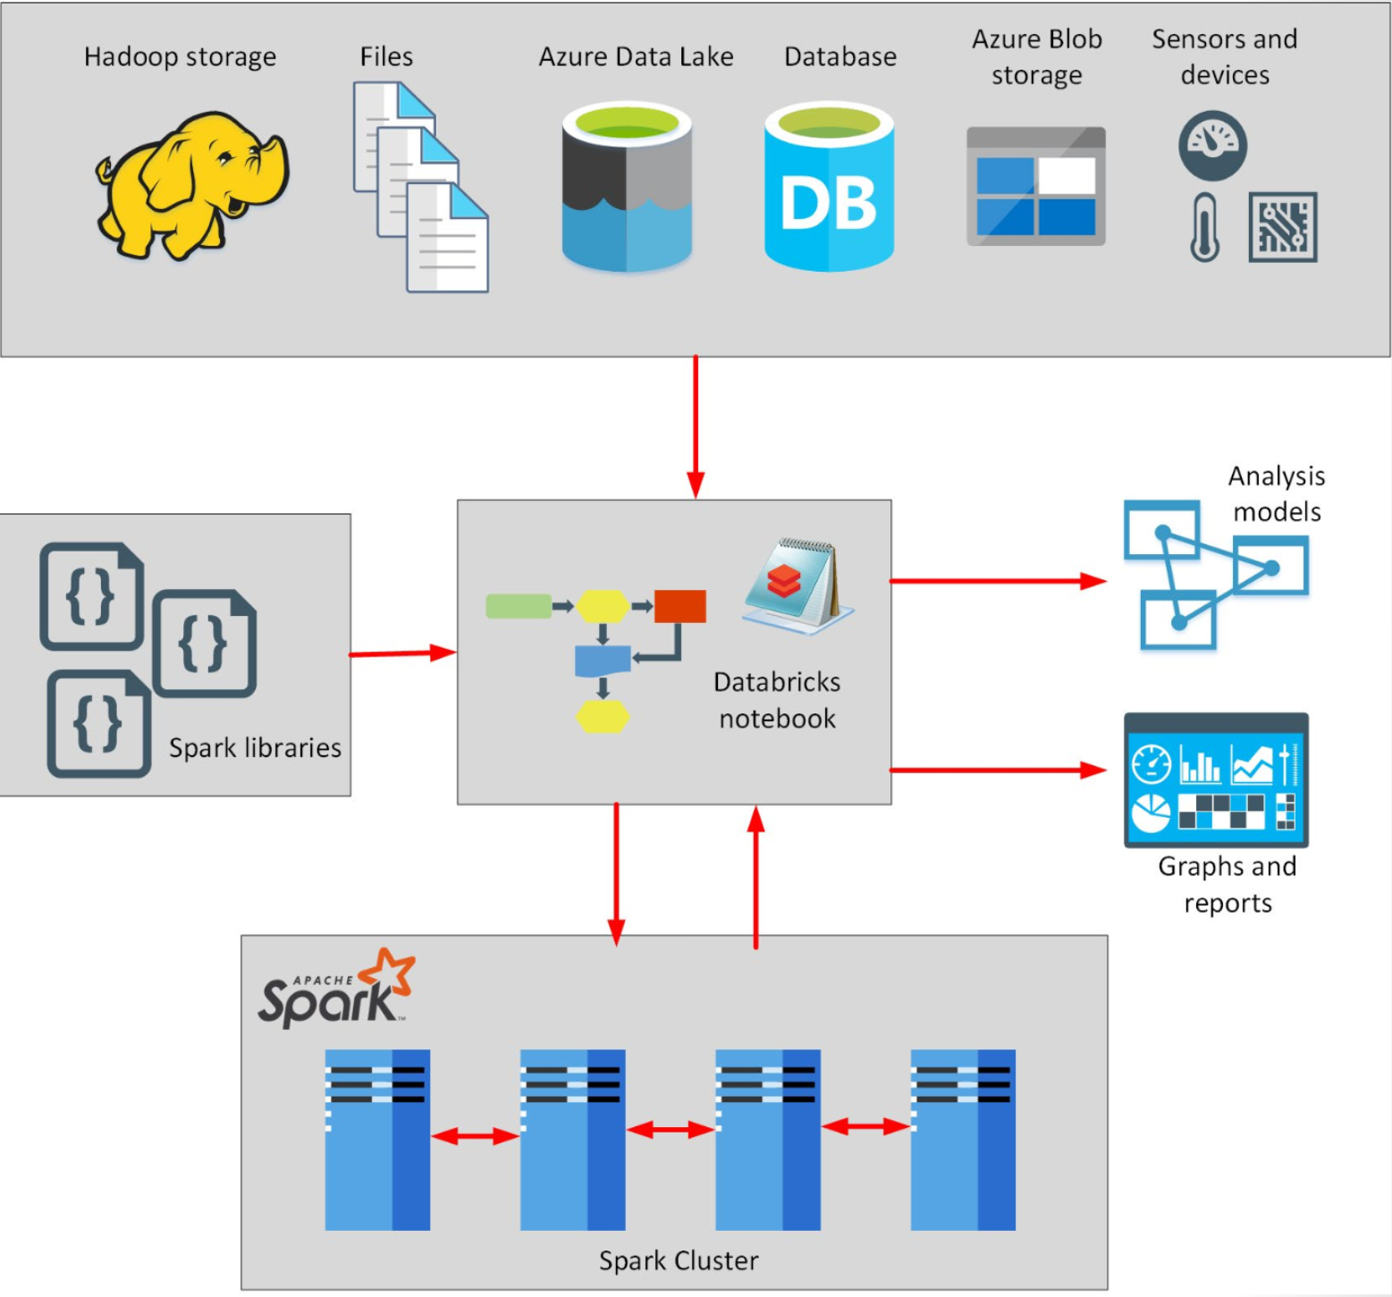
What is Azure HDInsight?
Notes:
Instructor notes
Azure HDInsight is a big data processing service, that provides the platform for technologies such as Spark in an Azure environment. HDInsight implements a clustered model that distributes processing across a set of computers. This model is similar to that used by Synapse Analytics, except that the nodes are running the Spark processing engine rather than Azure SQL Database.

Slide 69
Describe data ingestion in Azure
ADF
PolyBase
SSIS
70
100
80
Heterogenous
File based
Heterogenous
Notes:
Instructor notes
Azure Data Factory is a data ingestion and transformation service that allows you to load raw data from many different sources, both on-premises and in the cloud.
As it ingests the data, Data Factory can clean, transform, and restructure the data, before loading it into a repository such as a data warehouse. Once the data is in the data warehouse, you can analyze it.
PolyBase is a feature of SQL Server and Azure Synapse Analytics that enables you to run Transact-SQL queries that read data from external data sources. PolyBase makes these external data sources appear like tables in a SQL database.
Using PolyBase, you can read data managed by Hadoop, Spark, and Azure Blob Storage, as well as other database management systems such as Cosmos DB, Oracle, Teradata, and MongoDB.
SQL Server Integration Services (SSIS) is a platform for building enterprise-level data integration and data transformations solutions.
You can use SSIS to solve complex business problems by copying or downloading files, loading data warehouses, cleaning and mining data, and managing SQL database objects and data. SSIS is part of Microsoft SQL Server.
Databricks can process data held in many different types of storage, including Azure Blob storage, Azure Data Lake Store, Hadoop storage, flat files, SQL databases, and data warehouses, and Azure services such as Cosmos DB. Databricks can also process streaming data. For example, you could capture data being streamed from sensors and other devices.

Slide 70


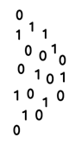


Describe components of Azure Data Factory
Linked Service
Triggers
@
Parameters
IR
Integration Runtime
Data Lake Store
Pipeline
CF
Control Flow
1
Activities
Azure Databricks
Dataset
Notes:
Instructor notes
Azure Data Factory can incorporate Azure Databricks notebooks into a pipeline. A pipeline can pass parameters to a notebook. These parameters can specify which data to read and analyze. The notebook can save the results, which the Azure Data Factory pipeline can use in subsequent activities.

Slide 71
Exam DP-900 Item Types

Slide 72

Multiple Choice

Slide 73
Repeated Scenario
You need to move an Azure VM to another hardware host.
Solution: You redeploy the VM.
Does this solution meet the goal?
Yes
No

Slide 74

Select and Place

Slide 75

Build List and Reorder

Slide 76

Active Screen/Fill in the Blank

Slide 77

Case Study

Slide 78






Performance-Based Lab

Slide 79
Microsoft Online Testing

Slide 80
Microsoft Online Testing Process
timw.info/online

Slide 81

Microsoft Online Testing Process

Slide 82

Microsoft Online Testing Process

Slide 83

Microsoft Online Testing Process

Slide 84

Microsoft Online Testing Process

Slide 85

Microsoft Online Testing Process

Slide 86

Microsoft Online Testing Process

Slide 87

Microsoft Online Testing Process

